Slide 1
ICE-DIP Introduction

Slide 2
The ICE-DIP Project

Slide 3
What is ICE-DIP?
ICE-DIP – The Intel-CERN European Doctorate Industrial Program
An EU EID project
– Within Framework Program 7
– Within the Marie-Curie mobility program
– Within the European Industrial Doctorate scheme
Purpose: research solutions for next generation data acquisition networks
Material from Andrzej Nowak - ICE-DIP overview

Slide 4
Science and Technology PoW
reference
Theme | WP | ESR | Challenge | Research
Silicon Photonics | WP1 | ESR1 | Need affordable, high throughput, radiation tolerant links | Design, manufacture, test under stress a Si- photonics link
Reconfi- gurable Logic | WP2 | ESR2 | Reconfigurable logic is used where potentially more programmable CPUs could be proposed | A hybrid CPU/FPGA data pre-processing system
DAQ networks | WP3 | ESR3 | Bursts in traffic are not handled well by off-the-shelf networking equipment | Loss-less throughput up to multiple Tbit/s with new protocols
High performance data filtering | WP4 | ESR4 | Accelerators need network data, but have very limited networking capabilities | Direct data access for accelerators (network- bus-devices-memory)
 |  | ESR5 | Benefits of new computing architectures are rarely fully exploited by software | Find and exploit parallelization opportunities and ensure forward scaling in DAQ networks
Material from Andrzej Nowak - ICE-DIP overview

Slide 5
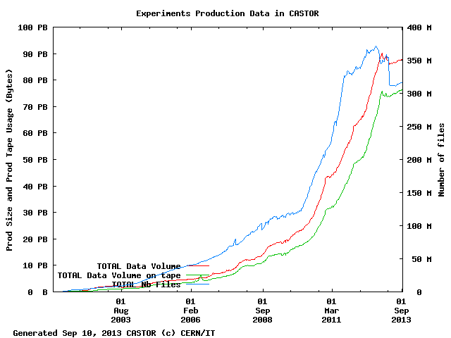
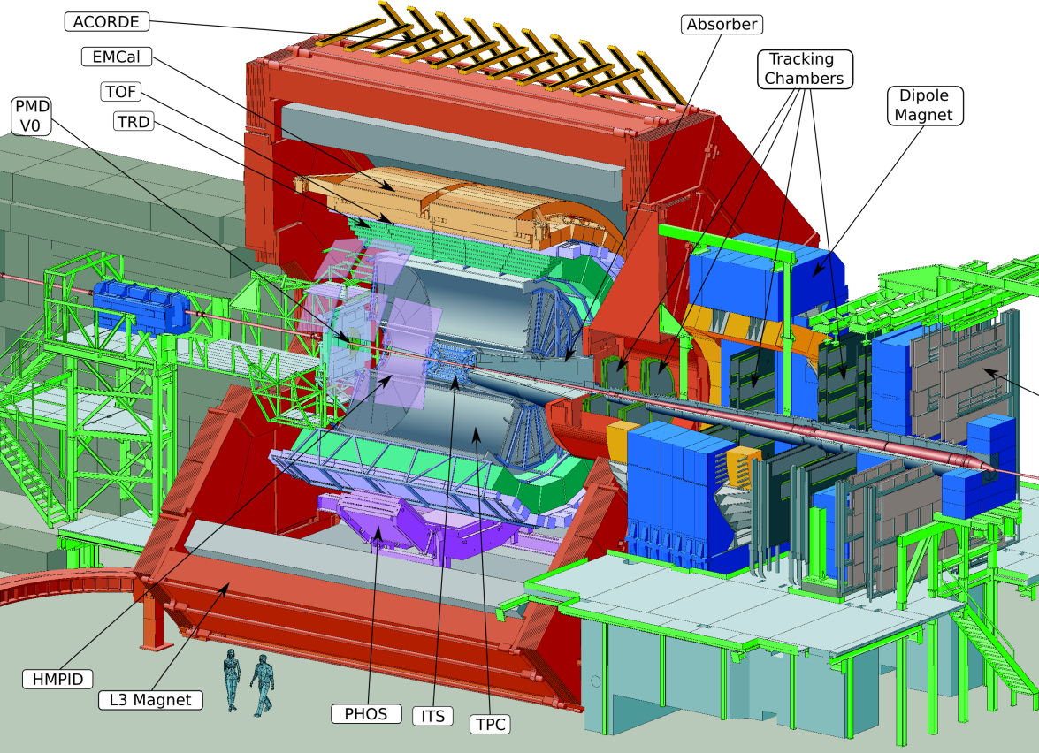
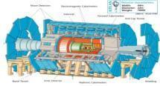
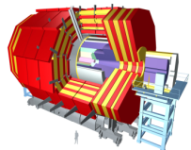
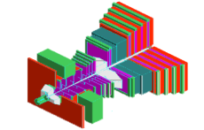
Big Science: lots of data !
 | Beam Type | Recording (Mass Storage) (GB/s) | Data Archived Total/Yr (PB)
ALICE | Pb-Pb | Design: 1.25 2009-2013: 4.00 2015: 10.00 | 2.3
ATLAS | pp | Design: 100 | 6.0
CMS | pp | Design: 100 | 3.0
LHCb | pp | Design: 40 | 1.0

Slide 6
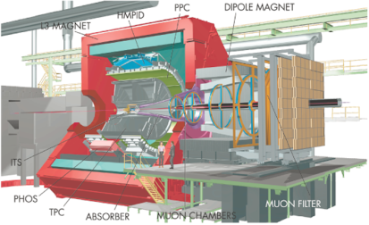
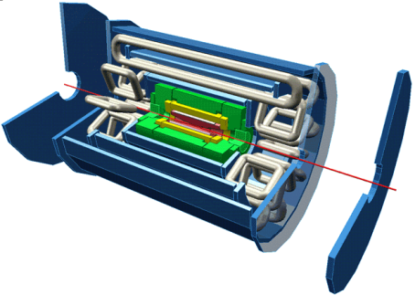
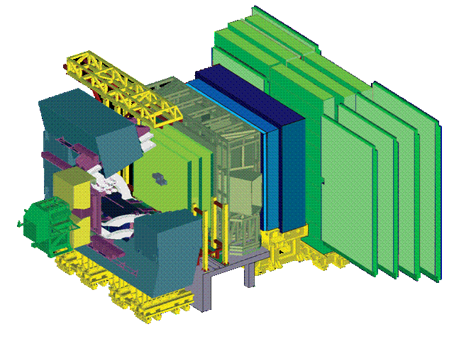
Readout Links of LHC Experiments
 | DDL | Optical 200 MB/s ≈ 400 links Full duplex: Controls FE (commands, Pedestals, Calibration data) Receiver card interfaces to PC | yes
 | SLINK | Optical: 160 MB/s ≈ 1600 Links Receiver card interfaces to PC. | yes
 | SLINK 64 | LVDS: 200 MB/s (max. 15m) ≈ 500 links Peak throughput 400 MB/s to absorb fluctuations Receiver card interfaces to commercial NIC (Myrinet) | yes
 | Glink (GOL) | Optical 200 MB/s ≈ 4000 links Receiver card interfaces to custom-built Ethernet NIC (4 x 1 Gbit/s over copper) | (no)
Flow Control
Material from N. Neufeld - ISOTDAQ (Intro to Trigger & DAQ) 01/2014
Notes:
Note that all these links are in the Gigabit / s class – in fact they are faster (about a factor 2). This trend is (unfortunately) broken with the GBT link, which is only 3.2 Gbit/s (net) as compared to the typical network link of the 201x (10 Gigabit/s) (exception ALICE DDL3)

Slide 7
General Overview
Tigger and DAQ
Data Acquisition System
trigger signals
decisions
Trigger System
raw data
design feedback
Mass Storage
Detector & Trigger Simulation
Reconstruction & Analysis
Physics Results
Material from W.Vandelli & A.Negri ­- Introduction to Data Acquisition–ISOTDAQ2014

Slide 8
Trigger & Data Acquisition (Conceptual)
Low-Level
Trigger
System
Detector
Electronics
Detector
Digitizers
Trigger
Level 0,1
Front-end Pipeline/Buffer
Decision
Trigger
Level 2
Readout Buffer
High-Level Trigger
or
Event Filter Farm
Decision
DAQ
System
Subevent Buffer
Event-Build. Netw.
High-Level
Trigger
Event Buffer
Decision
Storage network
Transient storage
Material from W.Vandelli & A.Negri ­- Introduction to Data Acquisition–ISOTDAQ2014
Permanent storage

Slide 9
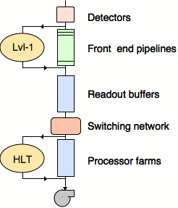
Trigger for LHC
No ((currently) affordable) DAQ system could read out O(10⁷) channels at 40 MHz → 400 TBit/s to read out – even assuming binary channels!
What’s worse: most of these millions of events per second are totally uninteresting: one Higgs event every 0.02 seconds
A first level trigger (Level-1, L1) must somehow* select the more interesting events and tell us which ones to deal with any further
Black magic happening here
(*) See any lecture on LHC trigger systems
Notes:
c.f. 2 500 000 000 simultaneous(!) phone conversations (practically everybody on the planet is on the phone - like 31st of December 23:59)

Slide 10
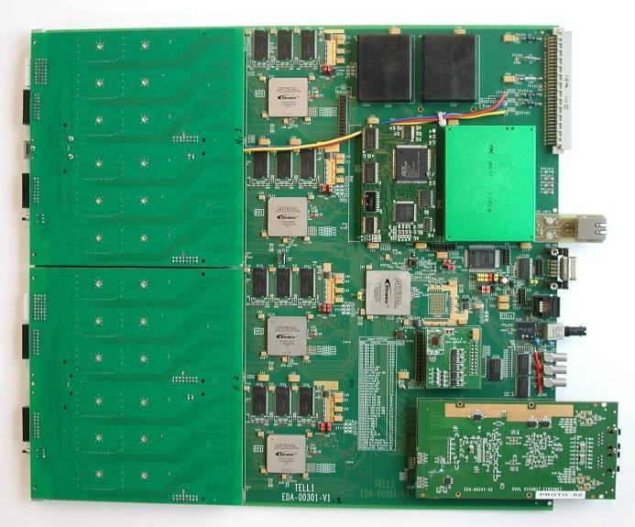
DAQ interfaces / Readout Boards
Front-end data reception
Receive optical links from multiple front-ends: 24 - 96
Located outside radiation
Event checking
Verify that data received is correct
Verify correct synchronization of front-ends
Extended digital signal processing to extract information of interest and minimize data volume
Event merging/building
Build consistent data structures from the individual data sources so it can be efficiently sent to DAQ CPU farm and processed efficiently without wasting time reformatting data on CPU.
Requires significant data buffering

Slide 11
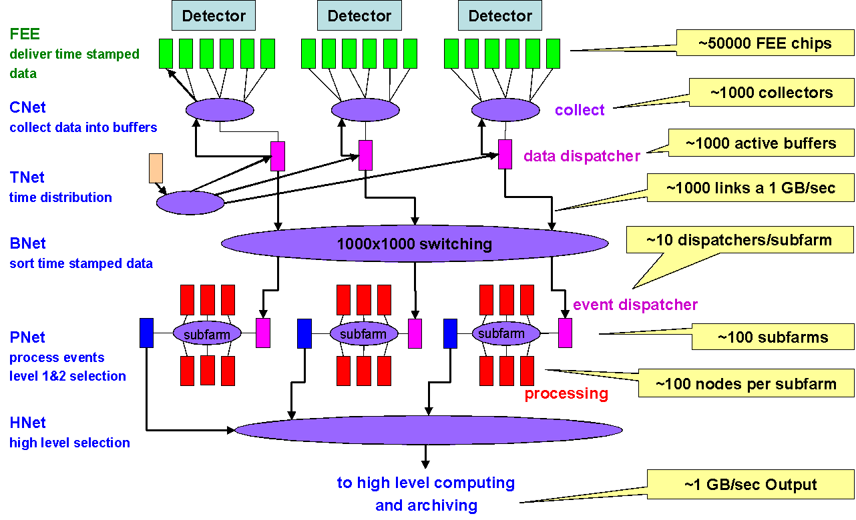
CBM DAQ Architecture

